Slide 1

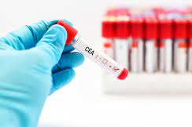
Predictive Healthcare: Machine Learning for Optimized CEA Testing in Colorectal Cancer Patients
Team members:
Ron Dickerson
Mahima Joshi
Janet Pan
Anuradha Ramachandran

Slide 2
Project Overview
Background: Patients who have completed curative treatment for colorectal cancer (CRC) should be followed up for the development of recurrent disease and require surveillance for five years post-treatment
Clinical guidelines: Suggest carcinoembryonic antigen (CEA) testing every three to six months
Statement of the Problem: In practice, patients do not receive frequent testing
Opportunity: Increase adherence to guideline-recommended testing; reduce cost
Aim:
Identify patient and physician characteristics that predict a patient's likelihood of being tested in the next three months
Build an interactive software system designed to help clinicians and policymakers with identifying patients for CEA testing using the model.
Data Source: de-identified Kaiser Permanente Southern California EHR database

Slide 3

User & Objectives: Physicians
Objectives:
Address the requirements of colorectal cancer patients.
Understand the likelihood of patient visits/CEA testing.
Provide tailored treatment/resources (e.g., upstream intervention).
Interaction:
Input necessary information using the interface.
Skill Level and Design Impact:
Limited technical expertise.
Interface must be user-friendly.
Opportunity cost/Efficiency

Slide 4

User & Objectives: Policy Makers (Governments, Health Providers, Insurers)
Objective:
Utilize the interface for predicting colorectal cancer patients' clinical visits/CEA testing outcomes and implementing targeted interventions.
Interaction:
Solely interact with the interface, inputting necessary information for predictions.
Skill Level and Design Impact:
Limited technical expertise; interface should prioritize user-friendliness.

Slide 5
Component Diagram: Supporting Clinicians and Policy Makers
Features input values
Prediction value
No
Validation check
Yes
Model fitting
Explore the data
Data
processing
Raw data frame (EHR)
Outlier detection
Fit model to train
Evaluation
Cleaned data frame with response and features
AUC and pick the best model
Standardize features
Merge physician characteristics

Slide 6
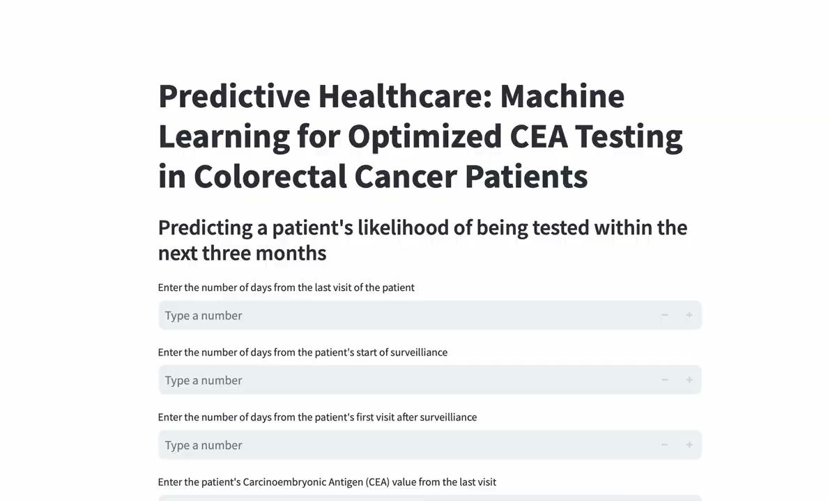
Demo: model_predict

Slide 7
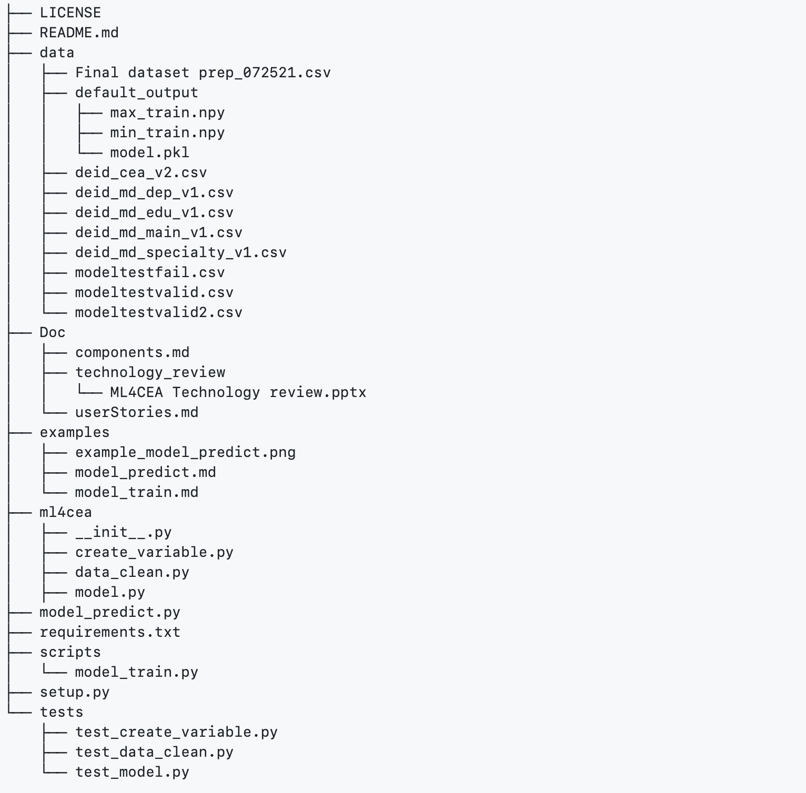
Folder Structure

Slide 8
Future direction
Conduct an extensive model test to identify the most fitting and predictive model for our data (e.g., consider non-linear combinations of predictors)
Host the website on a different server
Publishing findings in academic journals

Slide 9
Questions?

